Slide 1


Slide 2
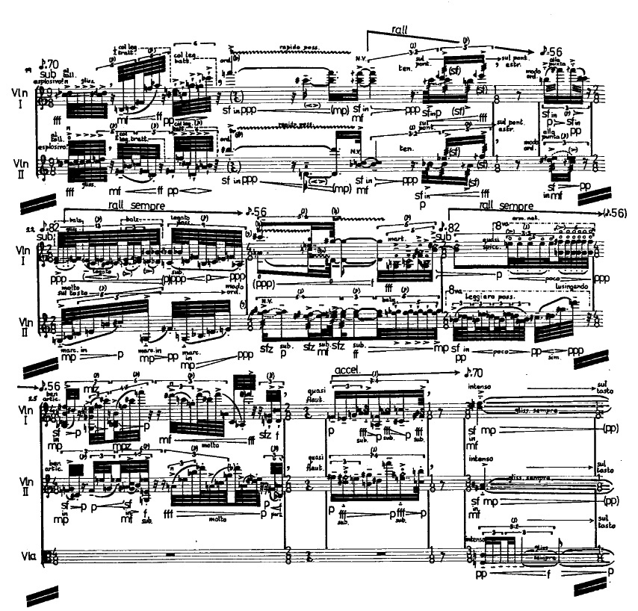
Chapter 2 Elements of Rhythm
MUS 112
January 25, 2017

Slide 3
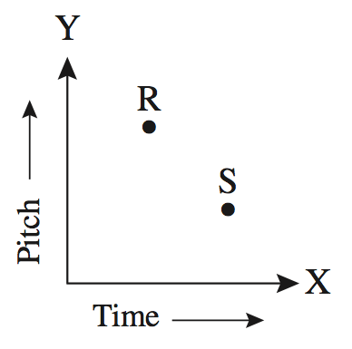
Rhythm
On Monday, we focused on how we describe the pitch aspect of music in notation.
Today, we will look at the time component, or Rhythm

Slide 4
Duration
The principal way we show time in music notation is be indicating the duration of a given note.
We show duration through a series of symbols that have been evolving from the beginning of written music to today.

Slide 5
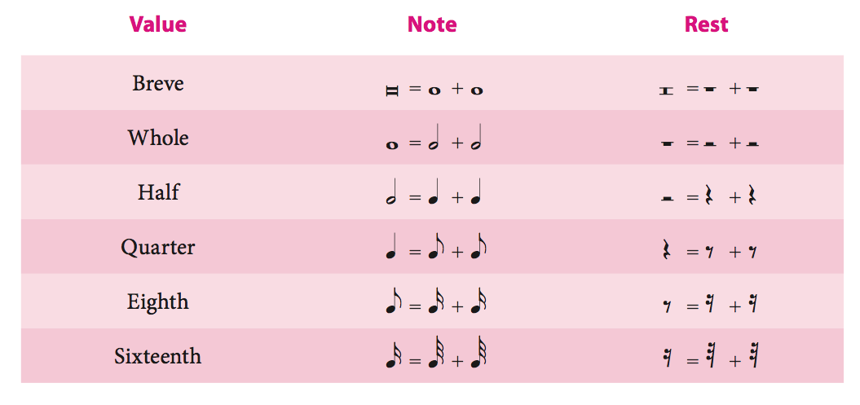
Duration Symbols

Slide 6
Dotted Durations
What happens when we add a dot after a duration?
Add ½ of the value of the preceding note or rest to the duration
What happens if we add another dot?
Add ½ of the value of the preceding dot to the duration
What happens if we add another dot?
Add ½ of the value of the preceding dot to the duration
What happens if we add another dot?
Add ½ of the value of the preceding dot to the duration
What happens if we add another dot?
Add ½ of the value of the preceding dot to the duration
What happens if we add another dot?
Add ½ of the value of the preceding dot to the duration

Slide 7
Beat & Tempo
We have almost all of our durations (bricks of time), but they are meaningless without a beat
Beat: the basic pulse of a musical passage
Tempo: the rate at which the beat occurs
We measure and indicate the pulse with the number of beats in a minute (BPM). q=76 would result in 76 evenly distributed beats in a minute.

Slide 8
Meter
Meter: consistent patterns into which beats are grouped
Groups of two, three, and four are the most common.
Each of these groups is called a measure
Measures are separated by barlines
There are two factors the make up the feel, or character, of the meter.
The grouping of the beat
Metric Accent
How the beat is subdivided
Division of the beat

Slide 9
Metric Accents
We refer to the number of beats in the make up a meter group in the following way:
Duple Meter: two-beat measure
Triple Meter: three-beat measure
Quadruple Meter: four-beat measure

Slide 10
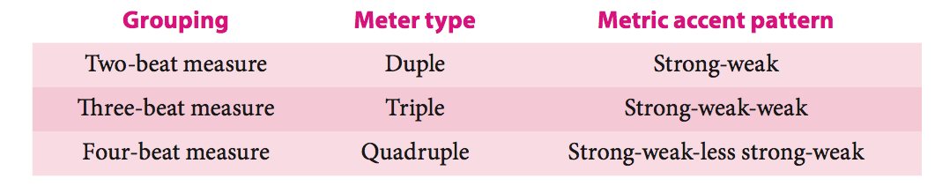
Metric Accents
Each of the preceding metric types stereotypically place stress on certain beats

Slide 11
Division of the Beat
Music is full of note durations that are shorter than a beat.
These are called divisions of the beat
A beat can be divided in to two or three equal parts
Two parts = simple beat
Three parts = compound beat
This is not the same as how the beat divides the meter

Slide 12
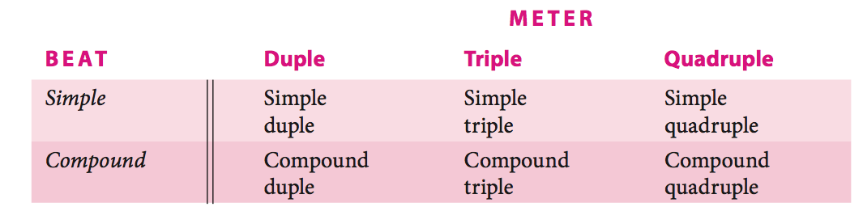
Meter
We combine the beat groupings and division of the beat to classify the meter

Slide 13
Time Signatures
time signature: a symbol that tells the performer how many beats will occur in each measure, what note value will represent the beat, and whether the beat is simple or compound.

Slide 14
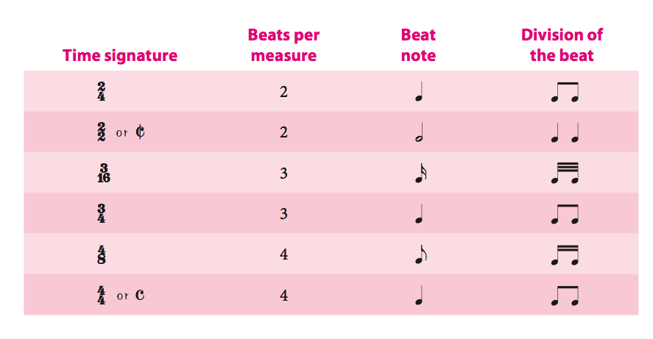
Simple Meter Time Signatures

Slide 15
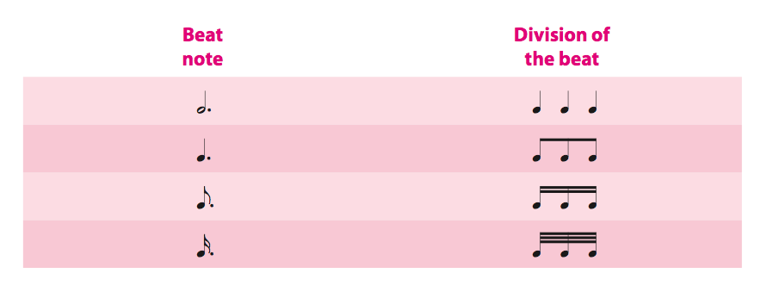
Compound Meter Time Signatures
If the beat divides into three equal parts, as in a compound beat, the note value represent- ing the beat will be a dotted value, as shown next.

Slide 16
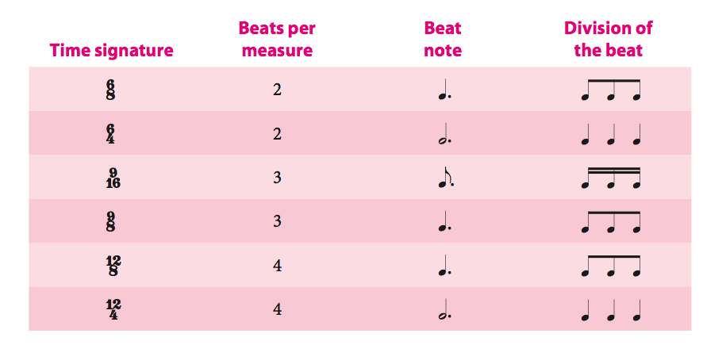
Compound Meter Time Signatures
As there is no way to represent a dotted duration in the bottom part of the time signature, we use the division of
the beat as the lower number, and the top number show the total division in a measure.
This number must be divisible by three

Slide 17
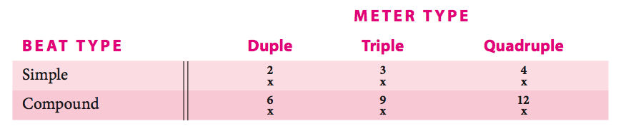
Time Signatures in Summary

Slide 18
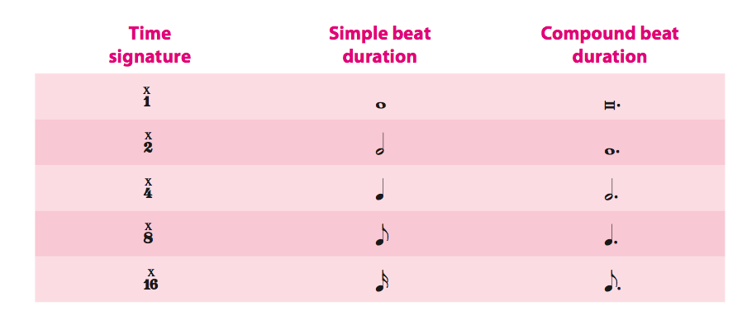
Time Signatures in Summary

Slide 19

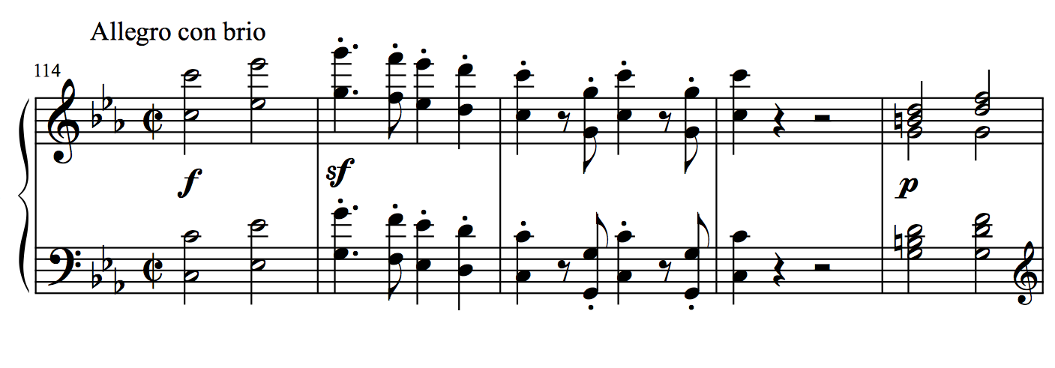
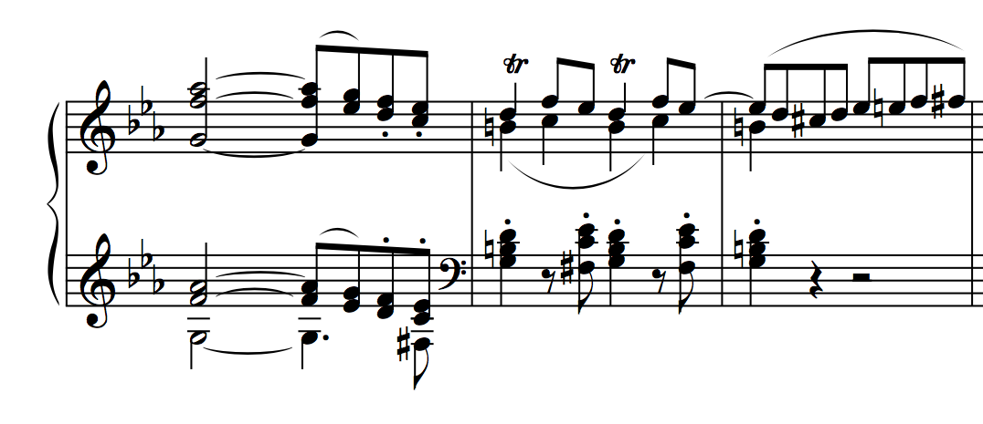
Simple Duple
Beethoven, Piano Concerto no. 3 in c minor, op. 37, mvt. 1, mm. 114-122

Slide 20
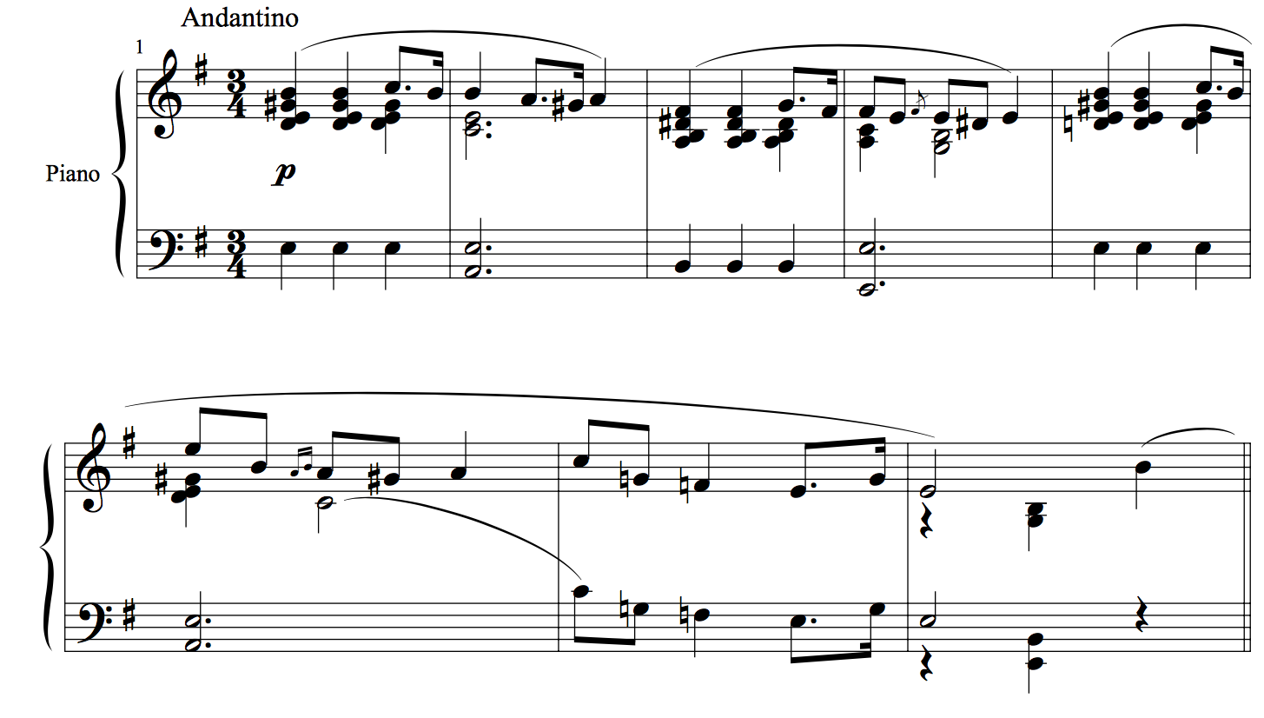
Simple Triple
Chopin, Mazurka, op. 41 no. 1, mm. 1-8

Slide 21
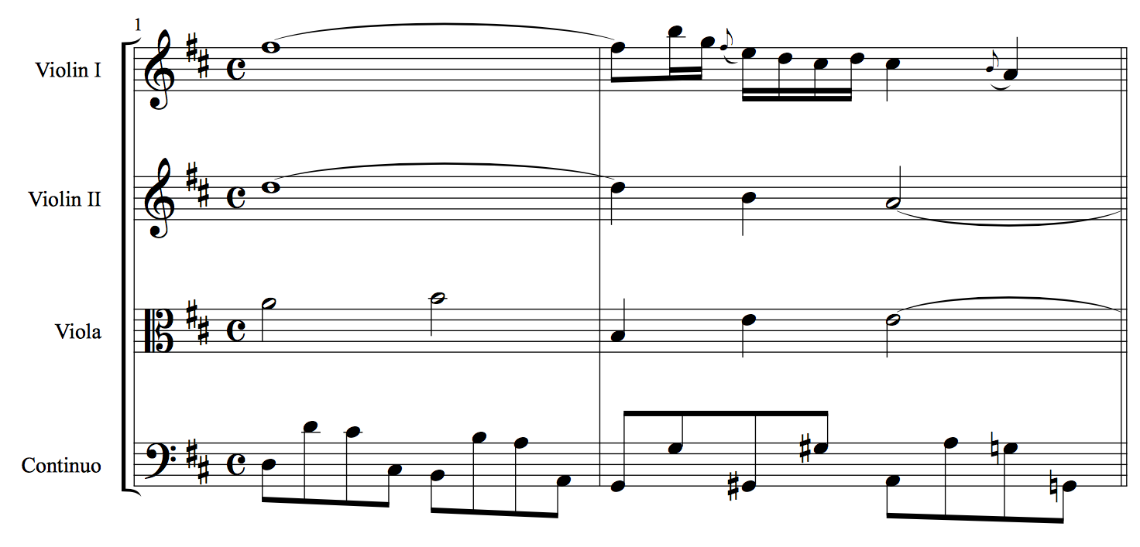
Simple Quadruple
J. S. Bach, Orchestral Suite no. 3 in D Major, BWV 1068, Air, mm. 1-2

Slide 22
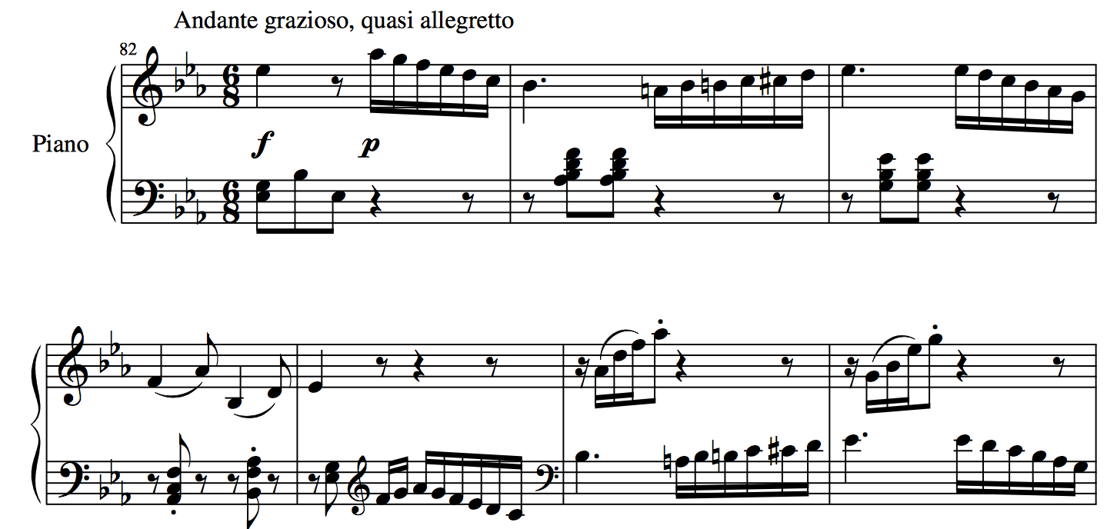
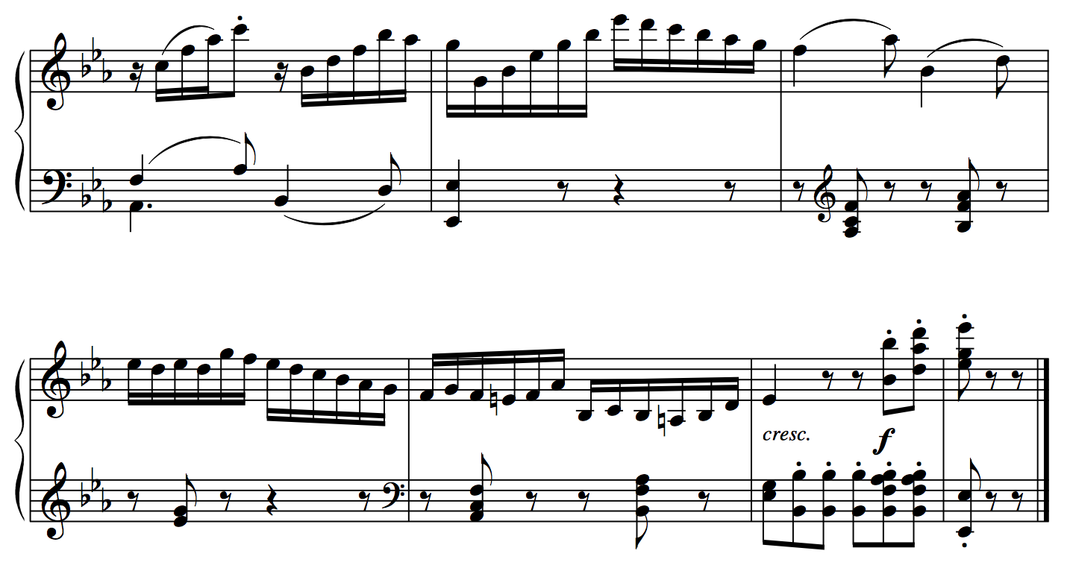
Compound duple
Beethoven, Bagatelle in E-flat Major, op. 33 no. 1, mm. 82-95

Slide 23
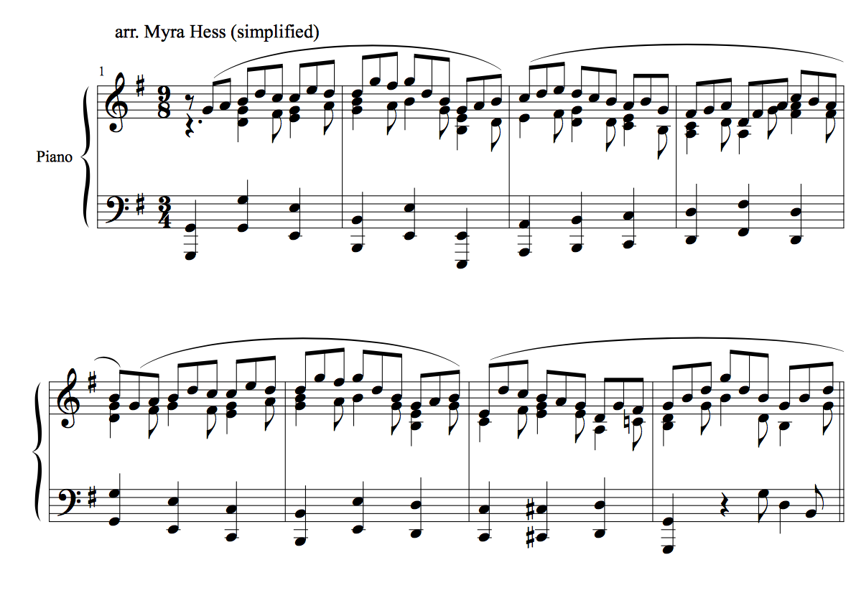
Compound Triple
J. S. Bach, Cantata no. 147, "Jesu, Joy of Man's Desiring" (arr. Hess), mm. 1-8

Slide 24
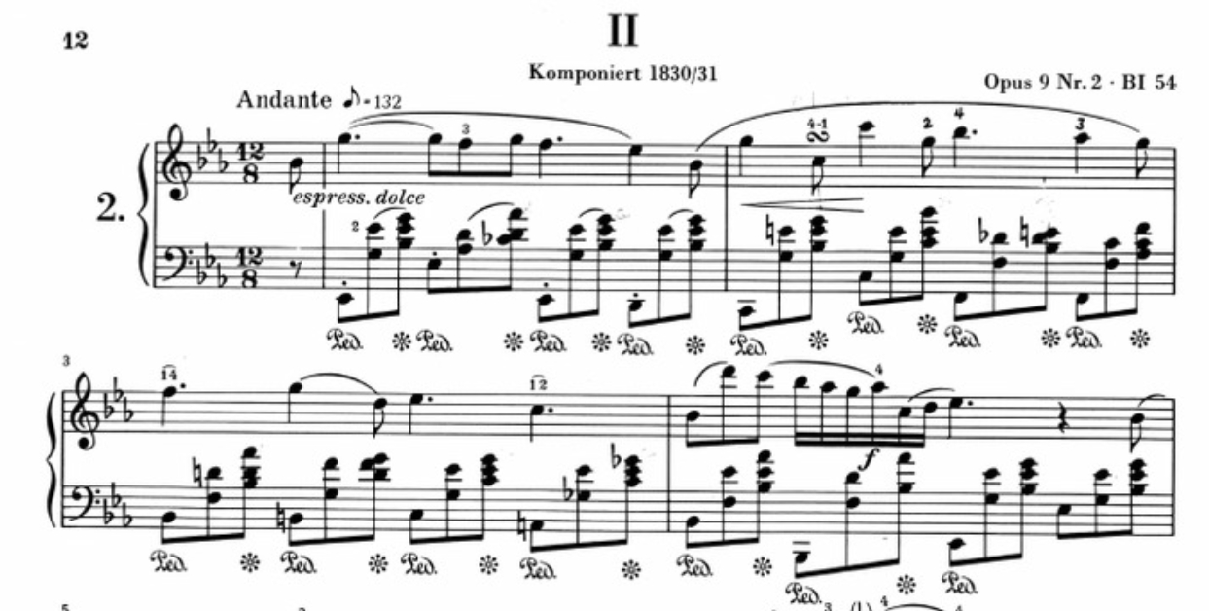
Compound Quadruple
Chopin, Nocturne in Eb major, op. 9, no. 2

Slide 25
Notating Rhythms
It is important (and helpful to the performer) to notate rhythms in a way that shows (reinforces) the meter.

Slide 26
____lets
Divisions of the beat, that go against the indicated meter
Duplets
Triplets
Quadruplets
Quintuplets
Etc…
https://www.youtube.com/watch?v=yxX6ZGHCP0I

